Slide 1
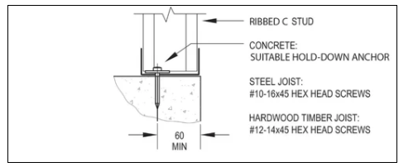
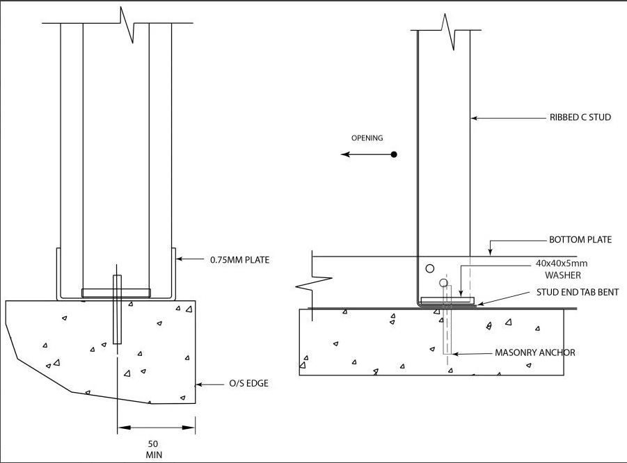
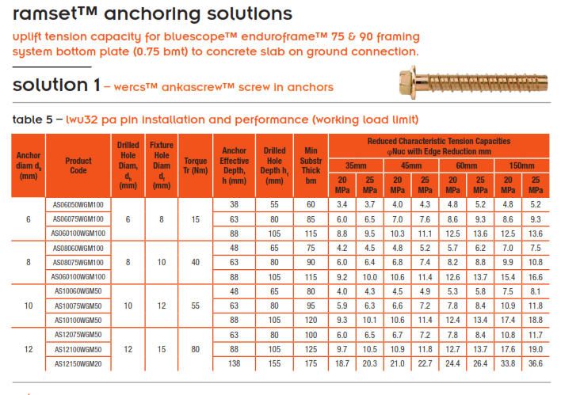
Bottom Plate Hold Downs Locations - Plan
Tie Down Bolt Selection
Typical Connection
Low Uplift Capacity – 4.8kN limit state
Use M6 x 75mm Ankascrew with 5mm thick round washer
Panel Junction
High Uplift Capacity – 12.7kN limit state
Use M12 x 100mm Ankascrew with 40 x 40 x 5mm square washer into bent tab
 | Tie Down Details | Client: XXX Address: XXX XXXX
 | Project: XXXXXXX

Slide 2
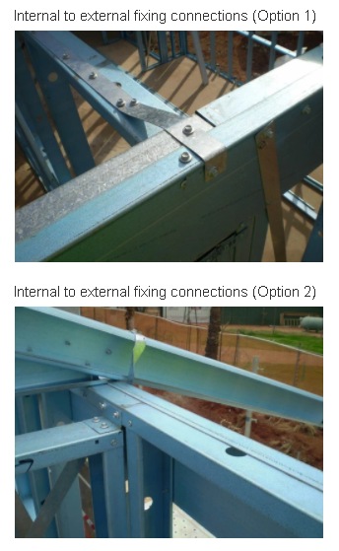
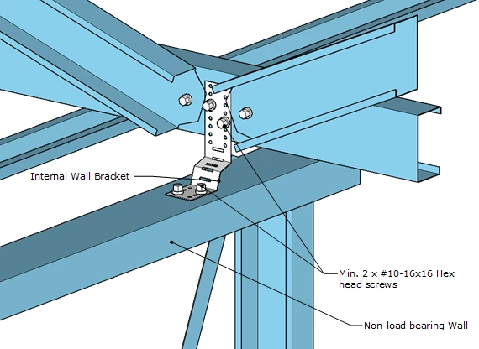
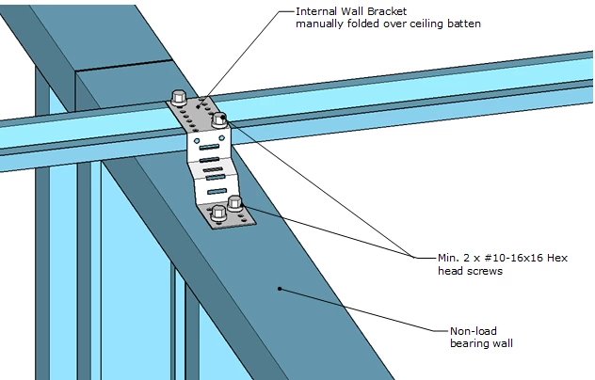
Load Bearing to Non-LB Wall Connections
Typical Connection
All wall panels to be screwed together with minimum 8 x 10-16x16 hex head or 12-14x20 hex head fasteners
Connecting Non-load bearing walls to roof trusses
 | Wall Connection Details | Client: XXX Address: XXX XXXX
 | Project: XXXX

Slide 3
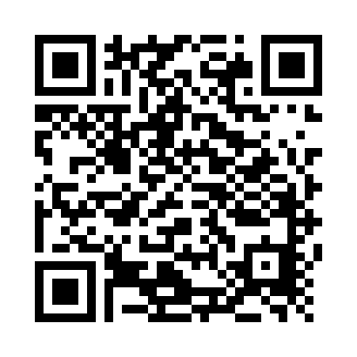
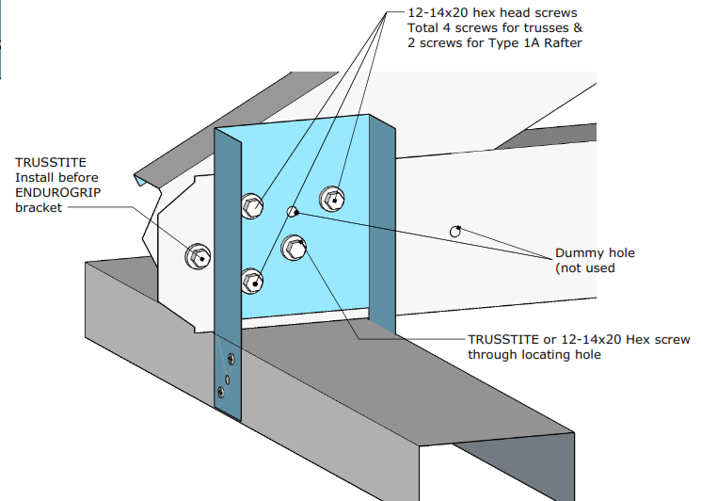
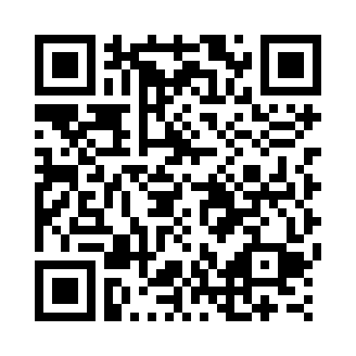
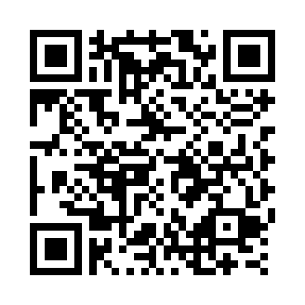
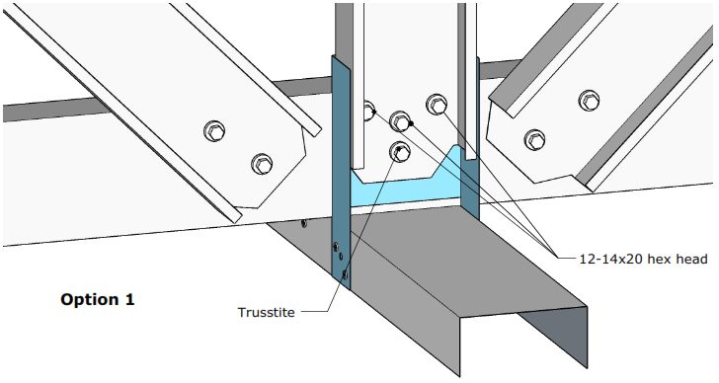
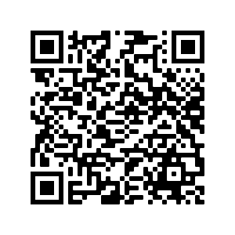
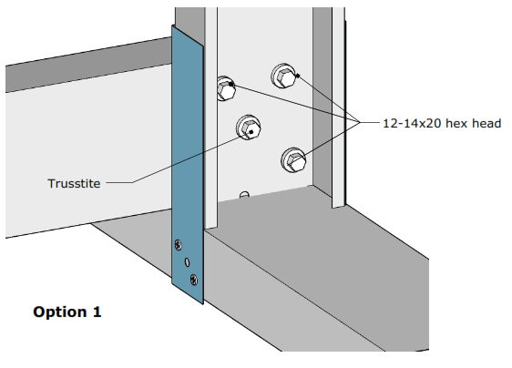
Truss & Rafter – Wall Connections
Scan this QR Code to view the installation videos
Scan this QR Code for more information on installing the ENDUROTRUSS® system
Scan this QR Code for more information on installing the ENDUROWALL® system
Scan this QR Code for more information on installing the ENDUROFLOOR™ system
All ENDUROGRIP brackets connected with 2 x M6-1Px18mm brackets on each side
 | Truss Tie Down Connection Details | Client: XXX Address: XXX XXXX
 | Project: XXXXX

Slide 4
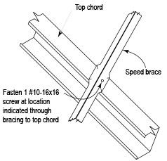
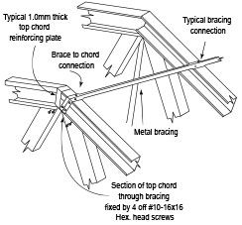
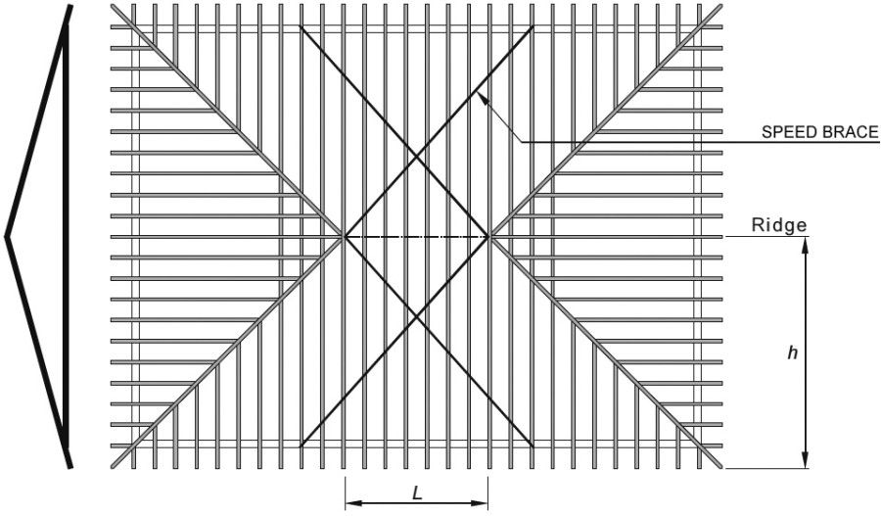
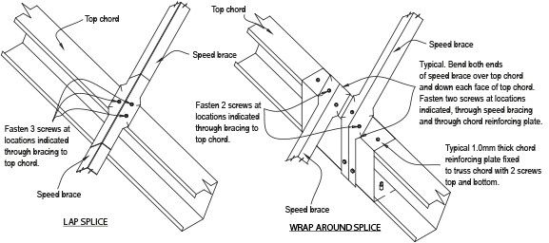
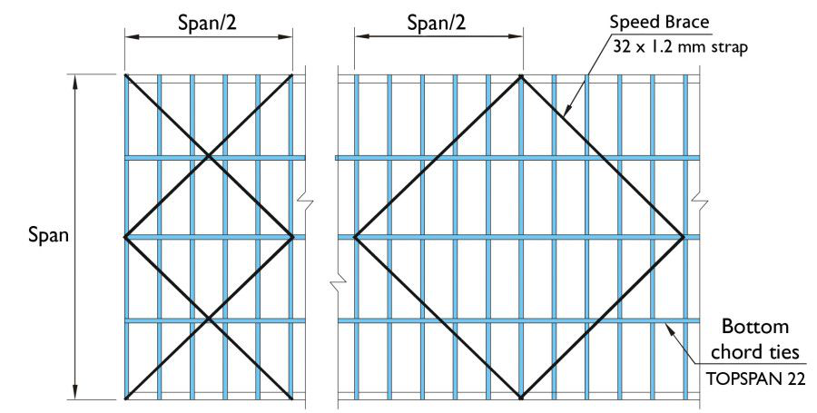
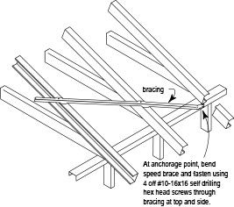
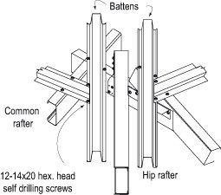
Top Chord Bracing
Bottom Chord Bracing
Hip rafter details
 | Roof Bracing Connection Details | Client: XXX Address: XXX XXXX
 | Project: XXX

